Slide 1
An Introduction to Linux

Slide 2
Learning outcomes
To become more familiar with using Linux:
learn how to connect to the Crop Diversity compute cluster
learn how to run basic commands in a non-graphical environment
become comfortable with navigating the Linux file system and creating, renaming, copying, deleting, editing files, etc

Slide 3
Getting connected
Requesting an account
https://help.cropdiversity.ac.uk/user-accounts.html
Mailing list:
everyone@cropdiversity.ac.uk
Contact us:
help@cropdiversity.ac.uk
https://cropdiversity-hpc.slack.com

Slide 4
Getting connected
Logging in while on-site
access available via username/password
Logging in while off-site
access only available via public/private keys
30 minute firewall ban after 3 failed attempts
Regardless of location:
ssh <username>@gruffalo.cropdiversity.ac.uk

Slide 5
Trusted networks
Crop Diversity HPC
143.234.80.224/27
JHI
SRUC
NIAB
NHM
RBGE
RBGK
UoSA
@home
SSH keys only
password or keys

Slide 6
Why we need SSH keys

Slide 7
SSH key pairs
https://help.cropdiversity.ac.uk/ssh-terminal-keys.html
Your public key allows anyone to encrypt a message that only your private key can decrypt
The server uses your public key to encrypt a challenge
When your private key decrypts and responds to that challenge, the server knows it’s you
On the assumption, of course, that only you have access to your private key; hence the CRITICAL requirement to keep your private key secure

Slide 8
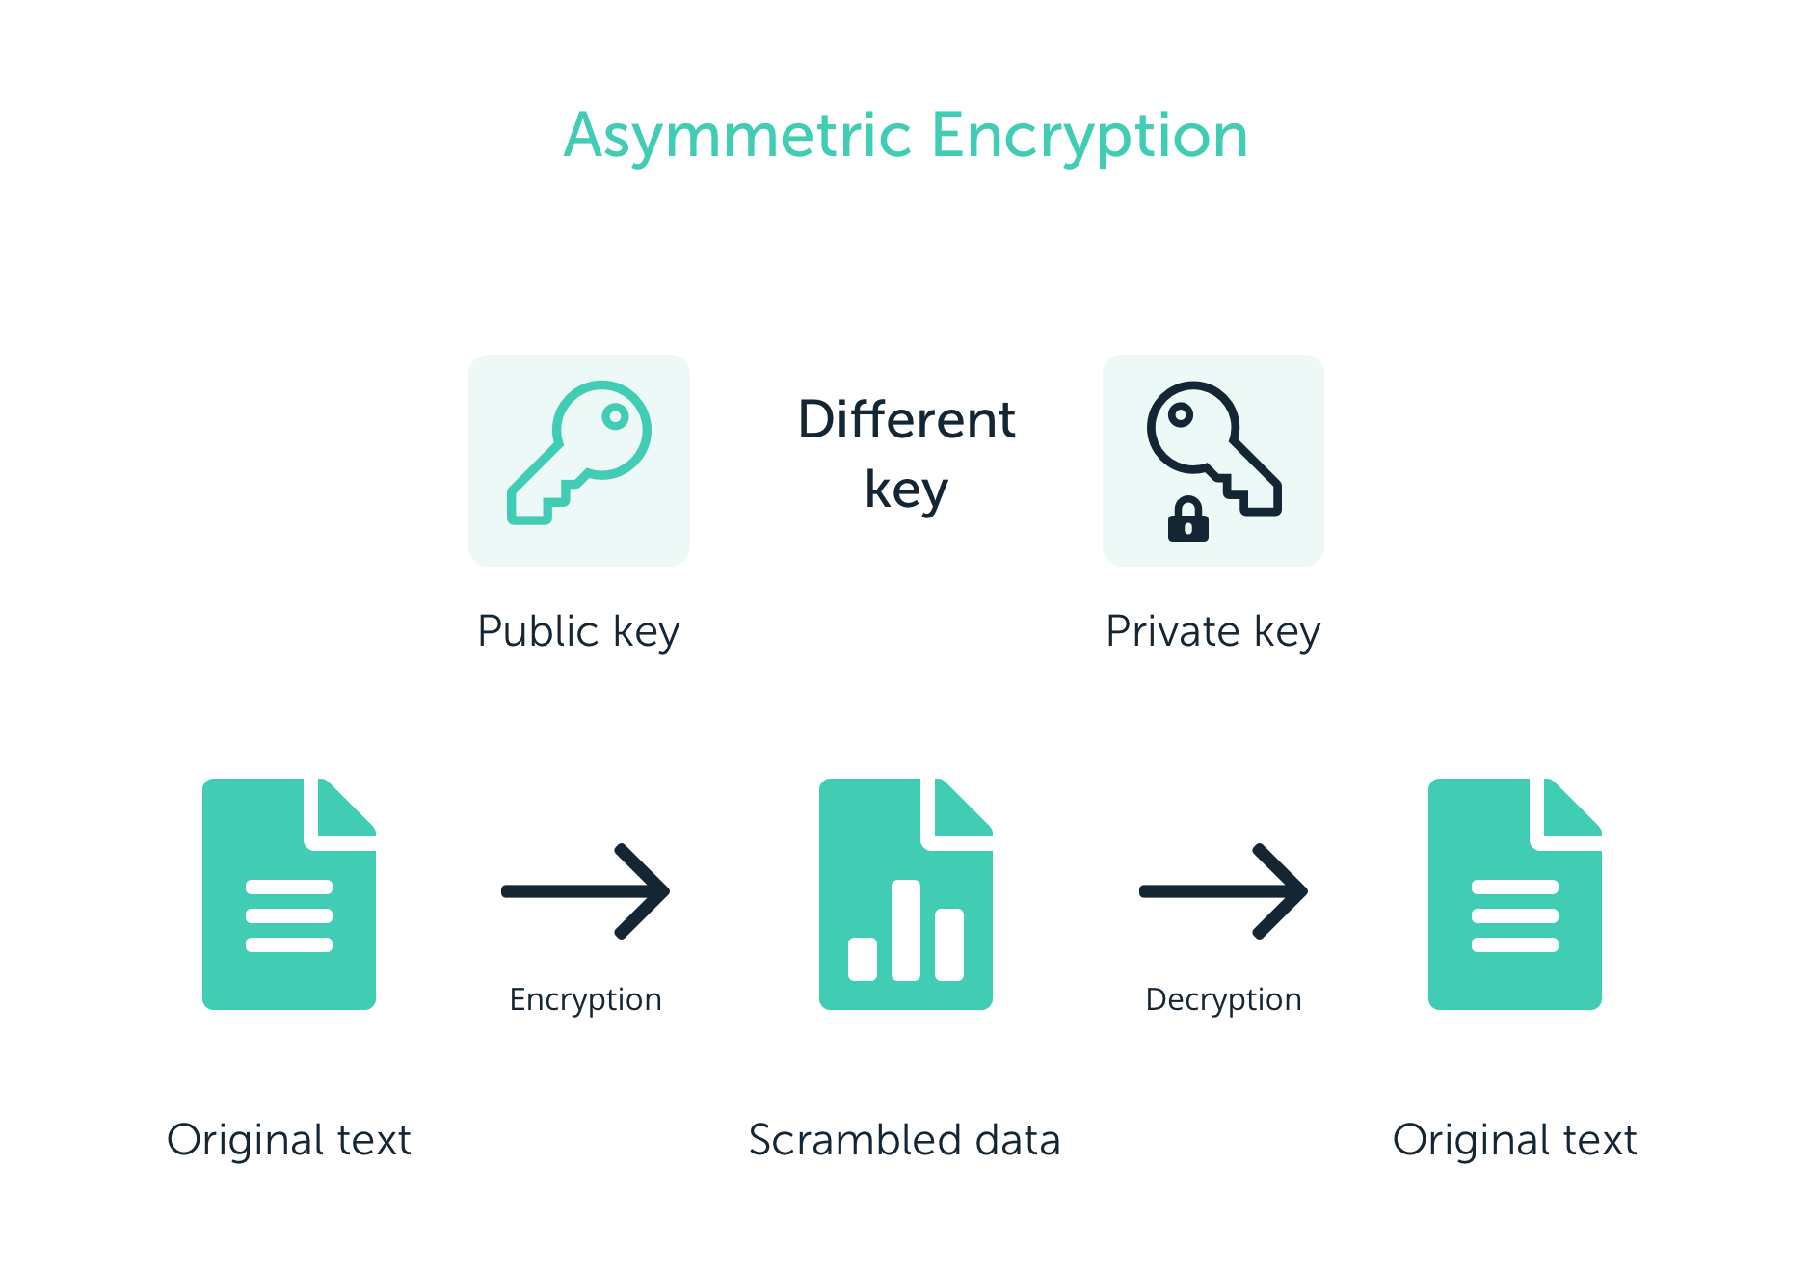
Asymmetric encryption

Slide 9

Why Linux?
Bioinformatics depends heavily on Linux-based computers and software
Notes:
Without linux, we wouldn’t be doing much bioinformatics
Linux is great: it’s low cost, it’s stable, it’s flexible…and it’s very powerful
Pretty much every single piece of bioinformatics software out there will be designed to run on it
And all the big supercomputers around the world use it

Slide 10
Why HPC?
Pre-processing, mapping, SNP discovery, etc on multi-TB barley exome capture data:

Slide 11
High-performance compute (HPC) cluster
All jobs running on the cluster must be submitted to one of its queues (more on that later)
See the queue and what’s running:
Submit an “interactive” job:
Disconnect from the child node and try it again – see which nodes you end up on…
you can disconnect by typing exit or by pressing CTRL+D
$ squeue
$ srsh -p debug

Slide 12
The Linux command-line
Our SSH connection gives us the ability to execute commands locally (on your PC) that will actually run on the cluster
Commands usually take the form of:
or
One letter options often use a single dash, eg: -f
Longer options often use a double dash, eg: --file
$ command --option
$ command --option value
Notes:
Explain how the shell relates to the keyboard, the screen, the operating system, and users' programs.
The heart of a CLI is a read-evaluate-print loop, or REPL: when the user types a command and then presses the enter (or return) key, the computer reads it, executes it, and prints its output. The user then types another command, and so on until the user logs off.
Can Handle larger files
example GO terms from a csv file
access option that may not be availble easily through GUI
Control – job manipulation
Linking process piping/scripting
Excellent for looping repetitive stuff vs GUI point-and-click

Slide 13
The Linux command-line
Type a command at the prompt and hit ENTER to run it
Many commands run quietly (and may not display any output while doing so)
When the prompt returns, the command has finished, and you can then enter another command
If needed, use CTRL+C to exit from a command early
you can test this with: ping cortana

Slide 14
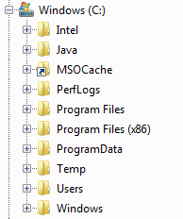
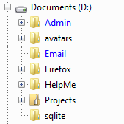
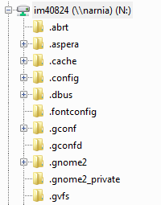
Navigating a Linux file-system
You should be used to concept of each hard drive (or network drive) in Windows mapping to a separate letter, eg C:\ or S:\
Think of each drive as a tree, with the folders as branches

Slide 15
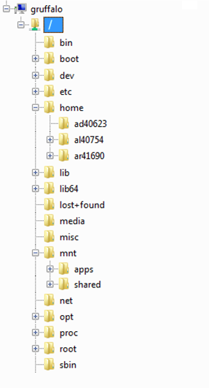
Navigating a Linux file-system
In Linux, all hard drives and network mounts form just a single tree, with its top level known as the root or / (“slash”)
Each branch might be another folder; or it could be another hard drive or network mount (with their own folders)

Slide 16

Storage spaces
More on this later, but the three key areas for storing data are:
home folders
/home
project folders
/mnt/shared/projects
scratch space
/mnt/shared/scratch
not backed up
Notes:
Shortcut to scratch and projects from each home folder

Slide 17
Navigating a Linux file-system
The path to locate any file or folder is defined from its position relative to /, eg:
/home/username/myFile
/mnt/shared/training
Changing directories on the command-line:
cd /mnt/shared/training
Relative paths can be used too:
cd /mnt/shared
cd training
Go back up (one) level:
cd ..
Notes:
Pay attention to path separators

Slide 18

Linux Practical…
https://cropdiversity.ac.uk/training/

Slide 19
Files and firewalls
local firewall
hpc firewall
client
gruffalo
a client (eg your laptop) can always connect TO gruffalo

Slide 20
Files and firewalls
local firewall
hpc firewall
client
gruffalo
but gruffalo can’t establish a connection to something BEHIND a firewall

Slide 21
Files and firewalls
local firewall
hpc firewall
client
gruffalo
server
unless that server also has its firewall configured to ALLOW incoming connections

